Slide 1



Cash Flow Minimizer
PROJECT MEMBERS
Mithik Karthikeyan(23ITR098)
MohanRaja.V(23ITR100)
Naveenkumar.V(23ITR111)

Slide 2

Many individuals struggle to keep track of income, expenses, and loans.
Poor financial management can lead to overspending and debt.
Users need a simple way to visualize their cash flow in real-time.
A user-friendly solution is needed to help manage personal finances effectively.

Slide 3
Objectives
To create a user-friendly Java-based application using Swing for personal finance management.
By leveraging a combination of Hashmap and linked lists, it facilitates the visualization and management of net cash flow, helping users monitor their financial health.
3

Slide 4
Software Tools used
Software:
Eclipse IDE
Imported Modules:
AWT
Events for AWT
Swing
LinkedList
Hashmap
JfreeChart
Modules Need to be Implemented:
AI suggestion
Natural Language processing
Application can be accessed by Everyone
4

Slide 5
Implementation Details
User Interface: Java Swing is used to create fields and buttons for adding income, expenses, setting goals, and viewing summaries.
Data Storage: Income and expenses are saved using HashMap and LinkedList for easy access and tracking.
Savings Goal Tracking: Users set a savings goal, with progress updated as savings grow.
Graph Visualization: A bar chart shows income vs. expenses for easy comparison.
Linked List Summary: A custom display shows income and expenses in a linked list format.
5

Slide 6
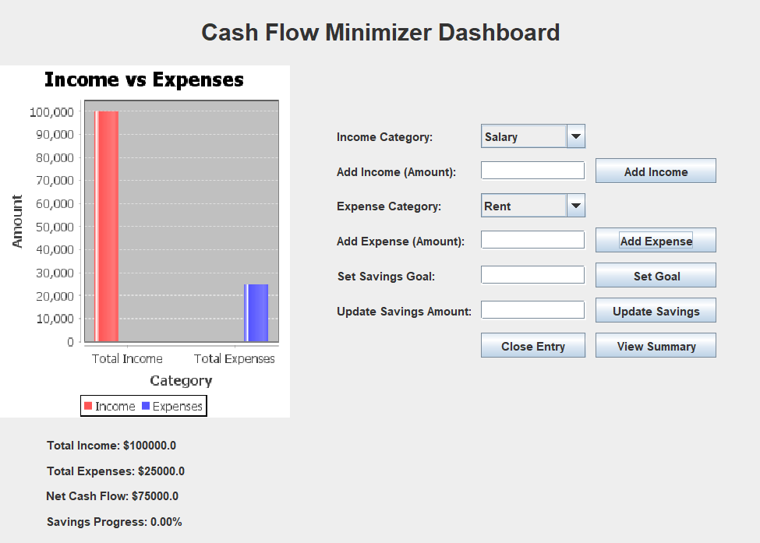
Main Dashboard

Slide 7
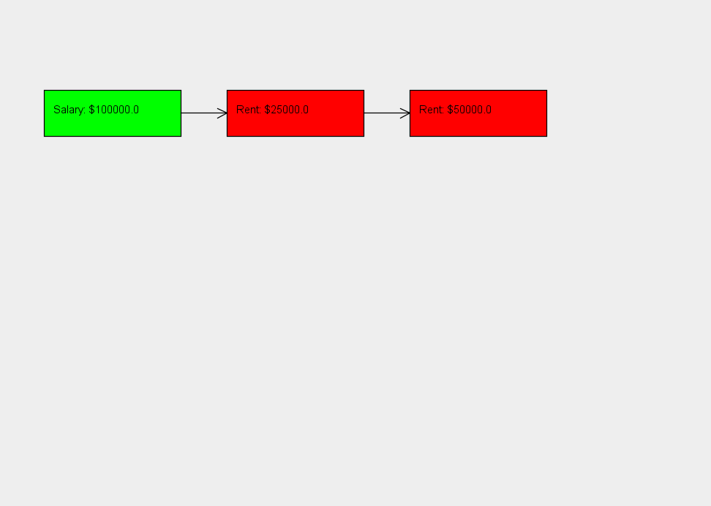
Node Representation

Slide 8
Thank You!

